Slide 1
R and Statistics short course
Reproducible research with R Marc Henrion, James Chirombo, Eva Kudowa, Vester Gunsaru

Slide 2
Introduction

Slide 3
Resources

Slide 4
Resources
Quarto & R markdown
https://quarto.org/docs/computations/r.html
https://rmarkdown.rstudio.com/articles.html

Slide 5
Open Science

Slide 6

Open Science
Discuss:
What do you understand by Open Science?
Why is Open Science important?

Slide 7
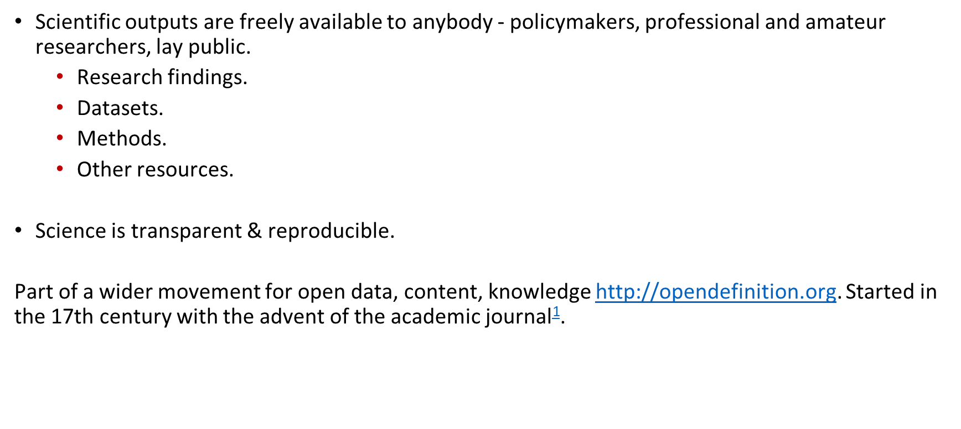
Open Science
Scientific outputs are freely available to anybody - policymakers, professional and amateur researchers, lay public.
Research findings.
Datasets.
Methods.
Other resources.
Science is transparent & reproducible.
Part of a wider movement for open data, content, knowledge http://opendefinition.org. Started in the 17th century with the advent of the academic journal¹.

Slide 8
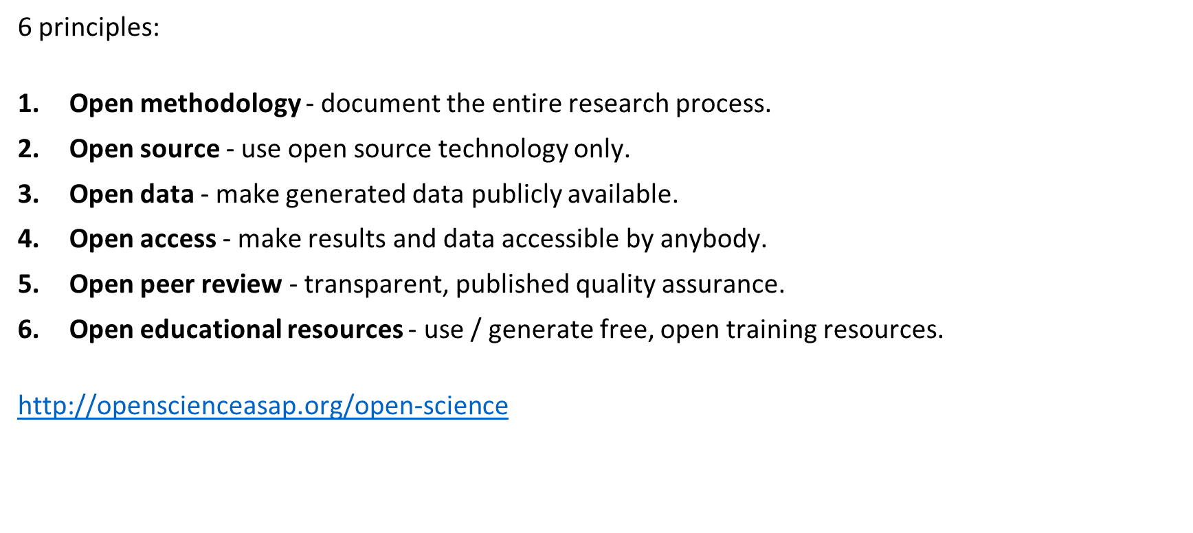
Open Science
6 principles:
Open methodology - document the entire research process.
Open source - use open source technology only.
Open data - make generated data publicly available.
Open access - make results and data accessible by anybody.
Open peer review - transparent, published quality assurance.
Open educational resources - use / generate free, open training resources.
http://openscienceasap.org/open-science

Slide 9
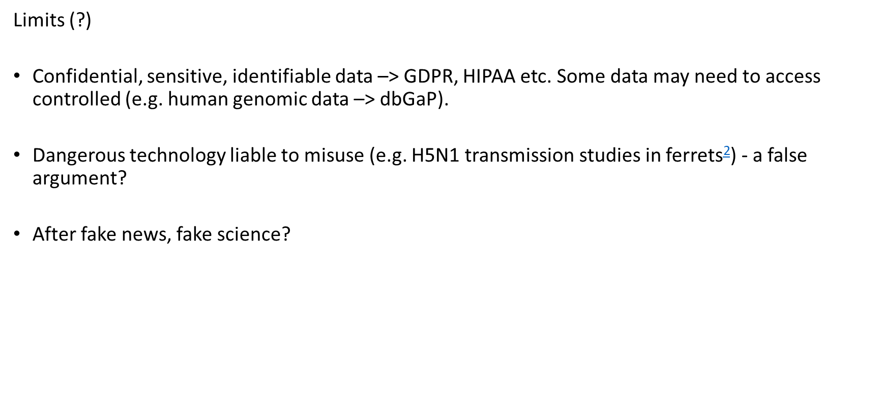
Open Science
Limits (?)
Confidential, sensitive, identifiable data –> GDPR, HIPAA etc. Some data may need to access controlled (e.g. human genomic data –> dbGaP).
Dangerous technology liable to misuse (e.g. H5N1 transmission studies in ferrets²) - a false argument?
After fake news, fake science?

Slide 10
Quarto / R markdown

Slide 11
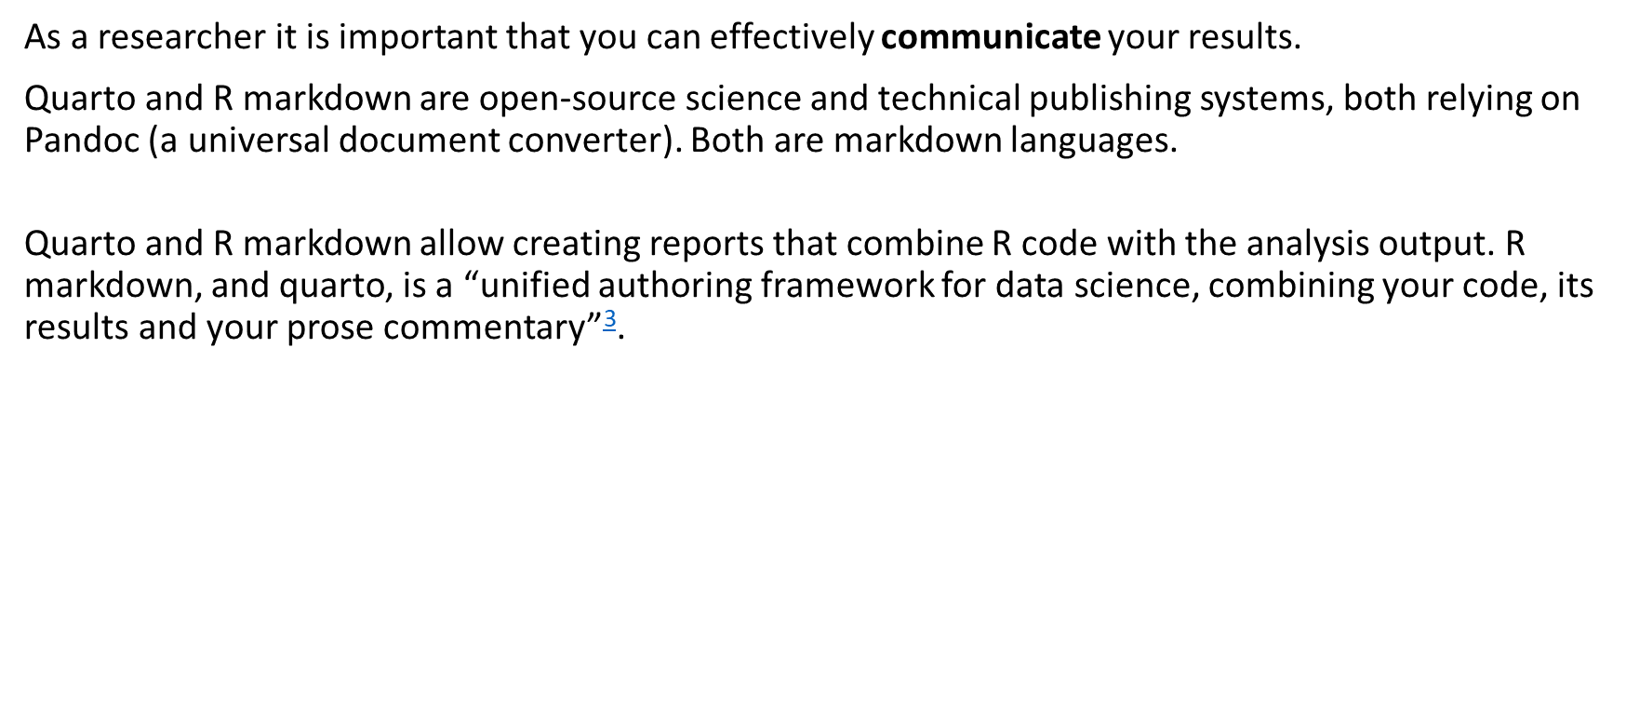
Quarto / R markdown
As a researcher it is important that you can effectively communicate your results.
Quarto and R markdown are open-source science and technical publishing systems, both relying on Pandoc (a universal document converter). Both are markdown languages.
Quarto and R markdown allow creating reports that combine R code with the analysis output. R markdown, and quarto, is a “unified authoring framework for data science, combining your code, its results and your prose commentary”³.

Slide 12
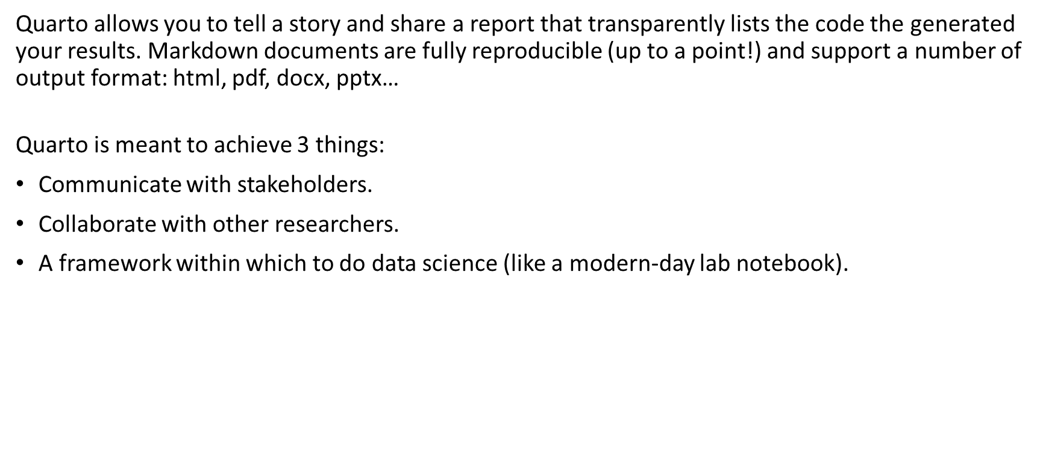
Quarto / R markdown
Quarto allows you to tell a story and share a report that transparently lists the code the generated your results. Markdown documents are fully reproducible (up to a point!) and support a number of output format: html, pdf, docx, pptx…
Quarto is meant to achieve 3 things:
Communicate with stakeholders.
Collaborate with other researchers.
A framework within which to do data science (like a modern-day lab notebook).

Slide 13
Quarto / R mardown
Main differences between quarto and R markdown:
Quarto is newer and will probably supersede R markdown - so best to just learn quarto (but both are almost identical to use).
Quarto is independent of R and works with many other programming languages (python, Julia, …)
Slight differences in YAML header specification.
Slightly different layout & style of final document.

Slide 14
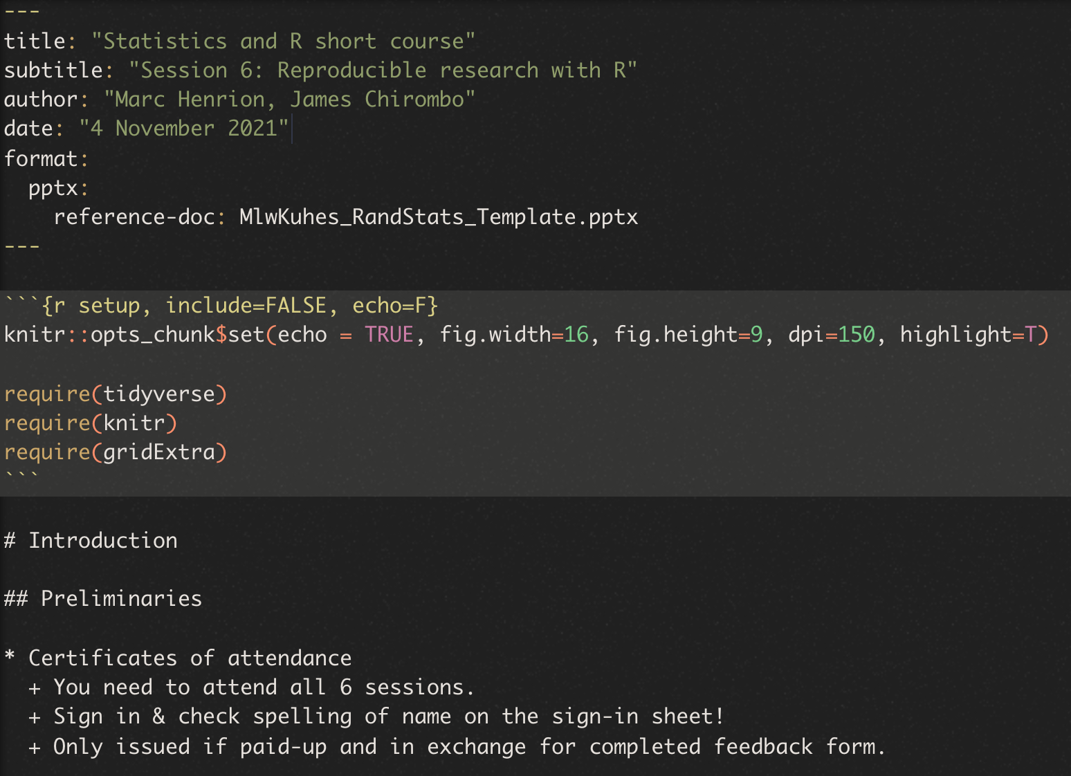
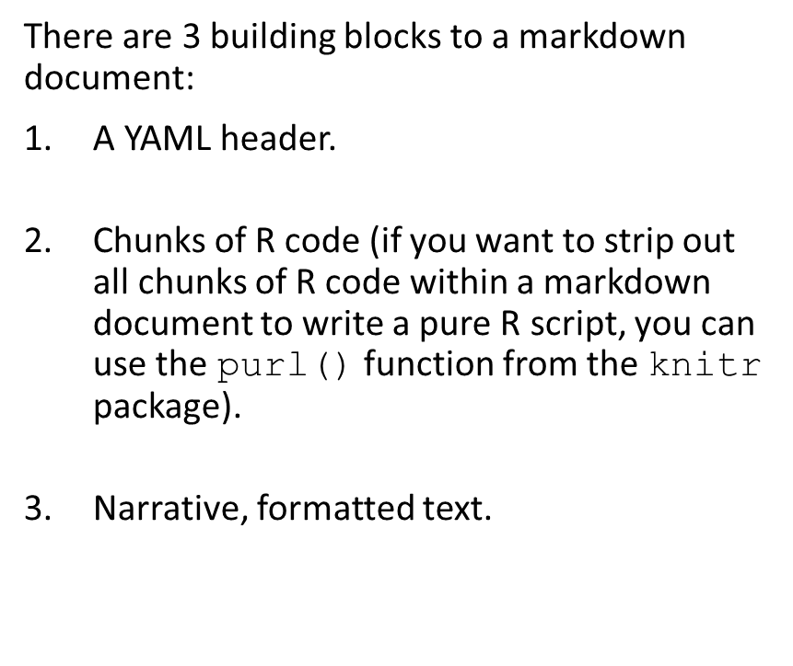
Quarto / R markdown
There are 3 building blocks to a markdown document:
A YAML header.
Chunks of R code (if you want to strip out all chunks of R code within a markdown document to write a pure R script, you can use the purl() function from the knitr package).
Narrative, formatted text.

Slide 15
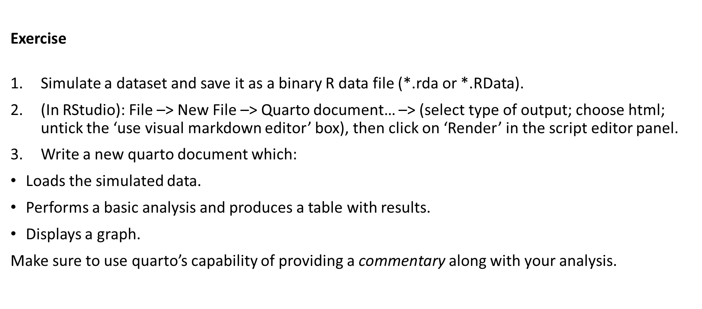
Quarto / R markdown
Exercise
Simulate a dataset and save it as a binary R data file (*.rda or *.RData).
(In RStudio): File –> New File –> Quarto document… –> (select type of output; choose html; untick the ‘use visual markdown editor’ box), then click on ‘Render’ in the script editor panel.
Write a new quarto document which:
Loads the simulated data.
Performs a basic analysis and produces a table with results.
Displays a graph.
Make sure to use quarto’s capability of providing a commentary along with your analysis.

Slide 16
Quarto / R markdown
Simulated data (as an example):
dat<-data.frame( type=sample(c("A","B"),size=100,prob=c(0.6,0.4),replace=T), x = rnorm(100,sd=5), y = rexp(100) ) dat$z<-ifelse(dat$type=="A", 2*x-y+5, 1.25*x-0.5*y+1) + rnorm(100,sd=1.25)

Slide 17
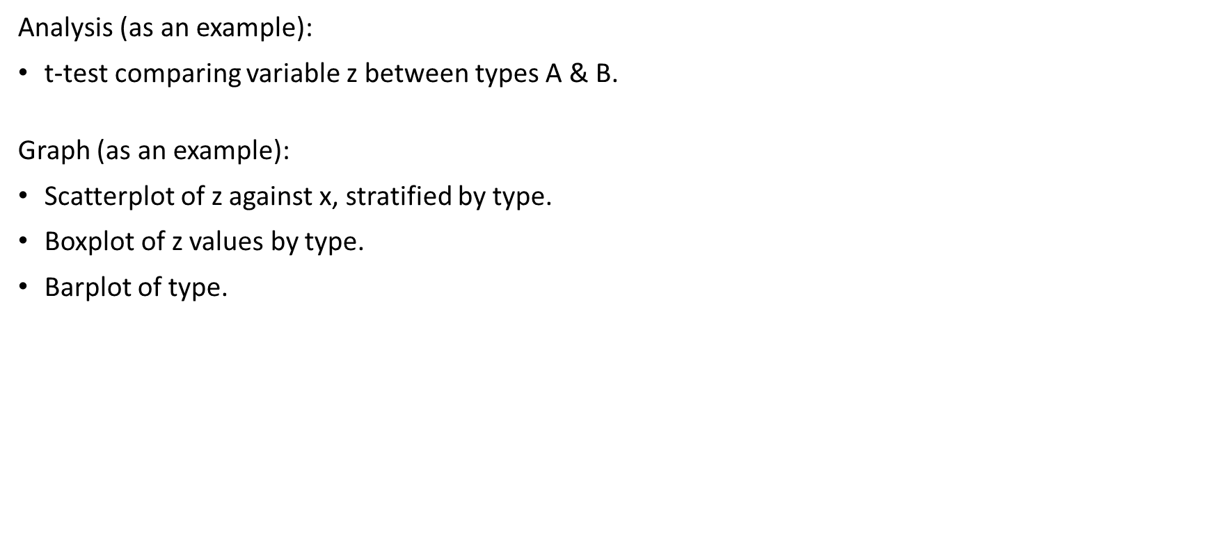
Quarto / R markdown
Analysis (as an example):
t-test comparing variable z between types A & B.
Graph (as an example):
Scatterplot of z against x, stratified by type.
Boxplot of z values by type.
Barplot of type.

Slide 18
[end of Session]

